Slide 1
Netflix Content Analysis
REPORTED BY: Yangareddy Sahithi

Slide 2

Business Objective
Analyze Netflix content trends, distribution patterns, audience targeting, and business insights.

Slide 3

Dataset Overview
Total Titles: 5332
Total Movies: 5185
Total TV Shows: 147
Total Countries: 604
Latest Release Year: 2021

Slide 4
Content Growth Analysis
Insight: Netflix content grew rapidly in recent years, reflecting platform expansion.

Slide 5
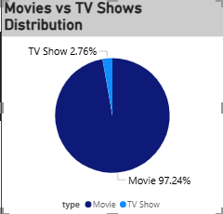
Movies vs TV Shows Analysis
Insight: Movies dominate the catalog with 97.24% of total content.

Slide 6
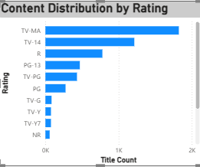
Ratings Analysis
Insight: TV-MA and TV-14 are the most common ratings.

Slide 7

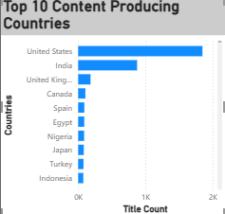
Country Analysis
Insight: United States, India, and United Kingdom are major content contributors.

Slide 8

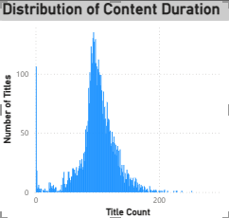
Duration Analysis
Insight: Most titles are concentrated within a common duration range.

Slide 9
Statistical Validation
H₀: Movies and TV Shows have the same average duration.
H₁: Movies and TV Shows have different average durations.
Statistical Test: Independent Samples T-Test
T-Statistic: 252.18
P-Value: < 0.001
Conclusion: Since the p-value is less than 0.05, we reject the null hypothesis. There is a statistically significant difference between the average durations of Movies and TV Shows.

Slide 10
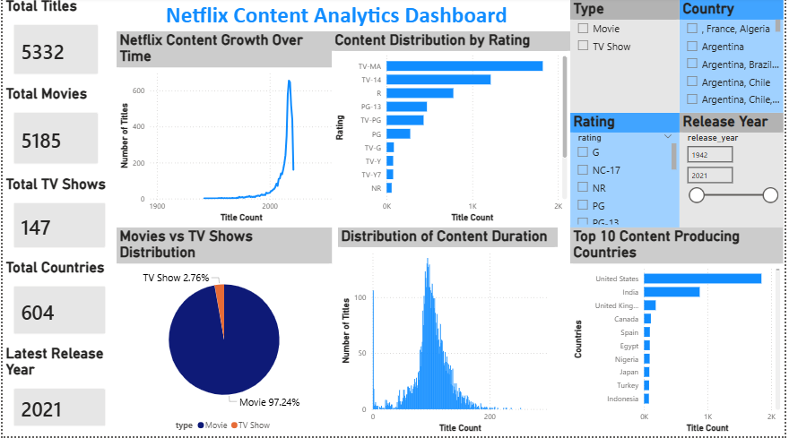
Dashboard Representation

Slide 11
Recommendations
Expand content diversity across countries.
Invest in high-performing genres.
Increase the production of TV Shows for long-term engagement.
Strengthen content development in emerging markets.
Use data-driven insights for future content acquisition.
Monitor KPIs through interactive dashboards for continuous improvement.

Slide 12
THANK YOU

